Slide 1
Data structures and algorithm
Recursion
Dr. Seemab Latif
Lecture No. 10
24th November, 2010

Slide 2
Today’s Lecture
In this lecture we will:
study recursion. Recursion is a programming technique in which procedures and functions call themselves.
look at the stack — a structure maintained by each program at run time.

Slide 3
Why Use Recursion
Recursively defined data structures, like lists, are very well-suited to processing by recursive procedures and functions.
A recursive procedure is mathematically more elegant than one using loops ➔ Easy to prove its correctness.
Sometimes procedures that would be tricky to write using a loop are straightforward using recursion.

Slide 4
Introduction
In C++, any function can call another function.
A function can even call itself.
When a function call itself, it is making a recursive call.
Recursive Call
A function call in which the function being called is the same as the one making the call.
Recursion is a powerful technique that can be used in the place of iteration(looping).
Recursion
Recursion is a programming technique in which procedures and functions call themselves.

Slide 5
Recursive Algorithm
Definition
An algorithm that calls itself
Approach
Solve small problem directly
Simplify large problem into 1 or more smaller subproblem(s) & solve recursively
Calculate solution from solution(s) for subproblem

Slide 6
Recursive Definition
A definition in which something is defined in terms of smaller versions of itself.
To do recursion we should know the followings
Base Case:
The case for which the solution can be stated non-recursively
The case for which the answer is explicitly known.
General Case:
The case for which the solution is expressed in smaller version of itself. Also known as recursive case.

Slide 7
Example 1
We can write a function called power that calculates the result of raising an integer to a positive power. If X is an integer and N is a positive integer, the formula for is
We can also write this formula as
Also as
In fact we can write this formula as

Slide 8
Example 1(Recursive Power Function)
Now lets suppose that X=3 and N=4
Now we can simplify the above equation as
So the base case in this equation is
int Power ( int x , int n )
{
if ( n == 1 )
return x; //Base case
else
return x * Power (x, n-1);
// recursive call
}

Slide 9
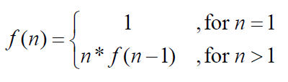
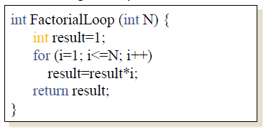
Factorial-- A Case Study
Factorial Function: Given a positive integer n, n factorial is defined as the product of all integers between 1 and n, including n.
Definition: n! = n* (n-1)* (n-2) * ……..*1
Mathematical Definition:
Implementation using loop

Slide 10
Factorial Case Study
Factorial definition
n! = n × n-1 × n-2 × n-3 × … × 3 × 2 × 1
0! = 1
To calculate factorial of n
Base case
If n = 0, return 1
Recursive step
Calculate the factorial of n-1
Return n × (the factorial of n-1)

Slide 11
Factorial Case Study
Here’s a function that computes the factorial of a number N without using a loop.
It checks whether N is smaller than 1. If so, the function just returns 1.
Otherwise, it computes the factorial of N – 1 and multiplies it by N.
int factorial(n)
{
if(n <= 1) //Base Case
return 1;
else
return n * factorial(n-1); //Recursion
}

Slide 12
Evaluation of Factorial Example
To evaluate Factorial(3)
evaluate 3 * Factorial(2)
To evaluate Factorial(2)
evaluate 2 * Factorial(1)
To evaluate Factorial(1)
evaluate 1 * Factorial(0)
Factorial(0) is 1
Return 1
Evaluate 1 * 1
Return 1
Evaluate 2 * 1
Return 2
Evaluate 3 * 2
Return 6

Slide 13
Recursive Programming
main
factorial(3)
return 6
factorial(3)
3 * factorial(2)
return 2
factorial(2)
2*factorial(1)
return 1
factorial(1)
1*factorial(0)
return 1
factorial(0)

Slide 14
Another Example--1
Here is a function to print all the elements of a linked list.
getFromList()extracts one item from the head of the list and than return the its value. In addition, it also return a new pointer pointing to rest of the list NOT include the returned item.
printAll()displays on the console ALL the items stored in the entire linked list. It terminates when the next pointer is pointing to NULL (i.e. empty).
int getFromList (Nodeptr &hdList)
{
int number;
number = hdList→data;
hdList = List→next;
return (number)
}
Void printAll (Nodeptr hdList)
{
cout<<“List of numbers are:”;
while (hdList != NULL)
{
cout<<getFromList(hdList);
}
}

Slide 15
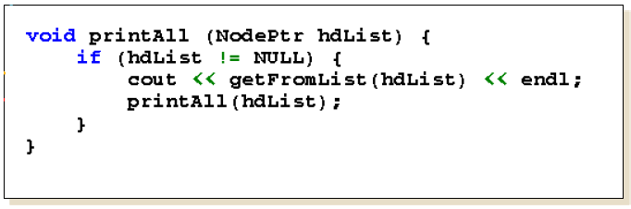
Another Example--2
The function below prints out the numbers in a list of numbers. Unlike the version of printAll in previous side, it doesn’t use a loop. This is how it works.
It prints out the first number in the list.
Then it calls itself to print out the rest of the list.
Each time it calls itself, the list is a bit shorter.
Eventually we reach an empty list, and the whole process terminates.

Slide 16
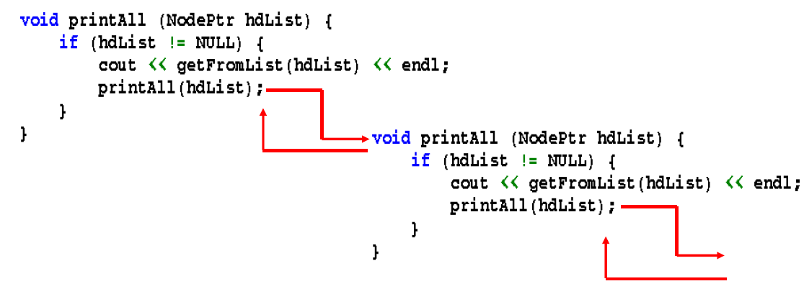
Visualization

Slide 17
Rules For Recursive Function
In recursion, it is essential for a function to call itself, otherwise recursion will not take place.
Only user define function can be involved in recursion.
To stop the recursive function it is necessary to base the recursion on test condition and proper terminating statement such as exit() or return must be written using if() statement.
When a recursive function is executed, the recursive calls are not implemented instantly. All the recursive calls are pushed onto the stack until the terminating condition is not detected, the recursive calls stored in the stack are popped and executed.
During recursion, at each recursive call new memory is allocated to all the local variables of the recursive functions with the same name.

Slide 18
The Runtime Stack during Recursion
To understand how recursion works at run time, we need to understand what happens when a function is called.
Whenever a function is called, a block of memory is allocated to it in a run-time structure called the stack.
This block of memory will contain
the function’s local variables,
local copies of the function’s call-by-value parameters,
pointers to its call-by-reference parameters, and
a return address, in other words where in the program the function was called from. When the function finishes, the program will continue to execute from that point.

Slide 19
Recursion in ADT
You can also use recursion in the data structures such as Stacks, queues, linked list, trees etc.
Task
Write a recursive function Search. Which will search the given number in the linked list.
Steps involved in searching
Base case
If list is empty or search reached end of the list, return false
If number is found in the list, return true
Recursive step
Perform recursion for the next node in the list until you find the required element.

Slide 20
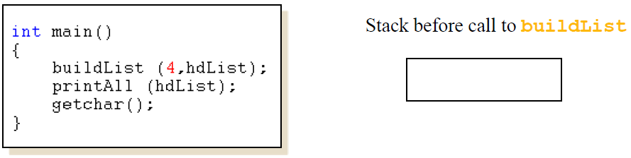
Function Call Example--1
Let’s look at an example. Here’s the main part of the program we have seen before.
The initial stack is empty. (Or might contain the program’s global variables, depending on implementation.)
What happens when the program calls buildList?

Slide 21
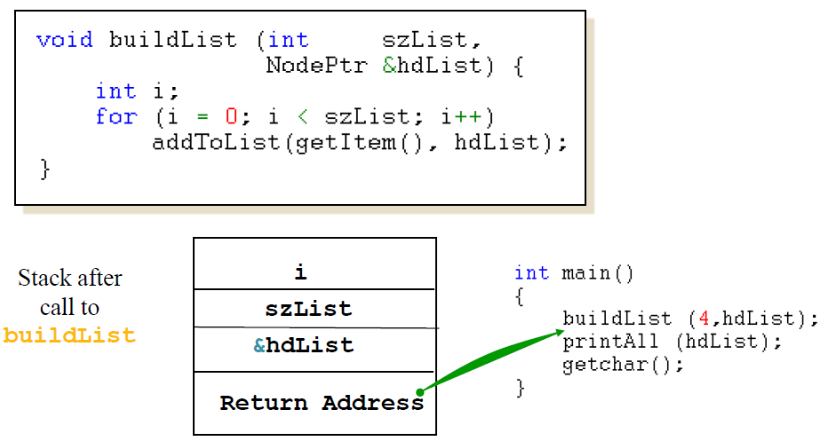
Function Call Example--2
The buildList function has one local variable, and one call-by-value parameter one call-by-reference parameter.
The local variable gets space on the stack, along with the value parameter and a pointer to the call-by-reference parameter.

Slide 22
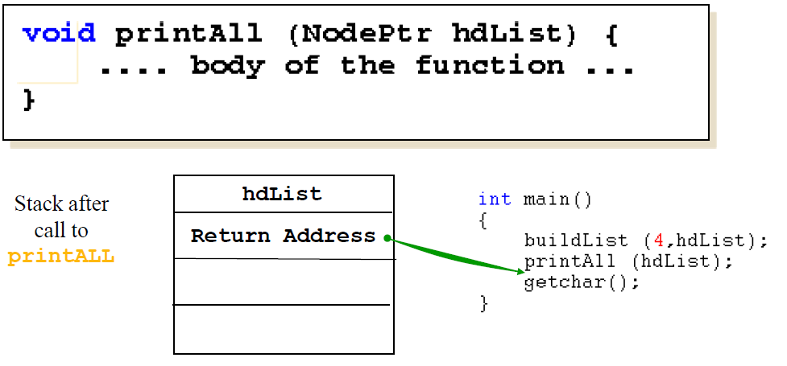
Recursive Function Calls--1
Now let’s look at the recursive calls to printAll.
The printAll function has no local variables, but one call-by-value parameter.

Slide 23
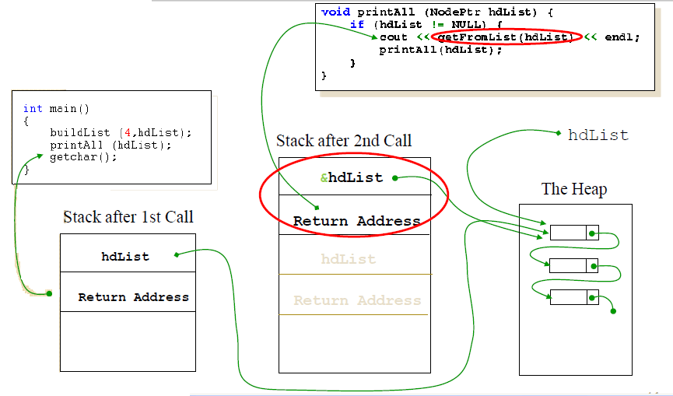
Recursive Function Calls--2
This is how the stack grows.
Note how successive calls move along the list.

Slide 24
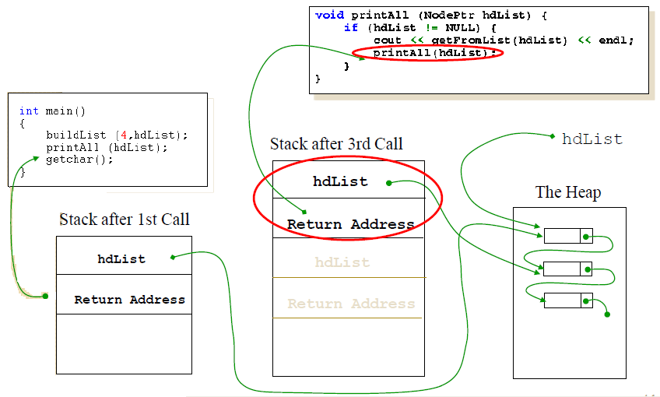
Recursive Function Calls--3

Slide 25
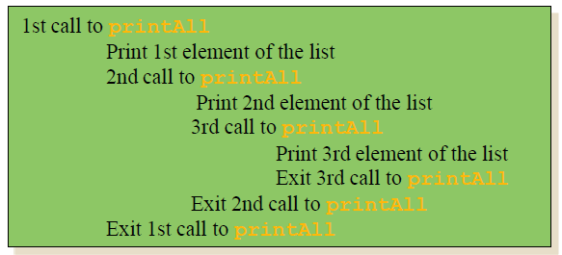
Recursive Function Calls--4
Eventually, printAll is called with the empty list as its argument.
Then there are no more recursive calls, and control is returned to the previous invocation of printAll , which in turn returns control to the one before, and so on until we are back in the main program again.
The stack shrinks in the opposite order to that in which it grew. The last element to be put on the stack is taken off first.
If there are three elements in the list, this is how the execution looks.

Slide 26
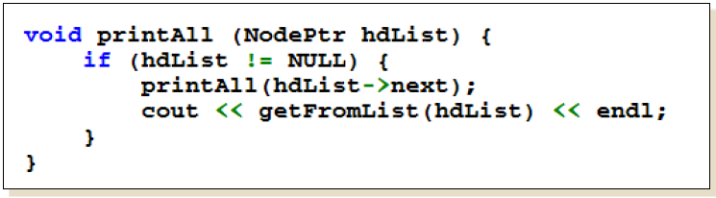
Brain Storming!!!
Printing the list out backwards using a loop is much harder.
It is possible to print the list from tail first with recursion???
It is identical to the printAll program, except that the two lines inside the if statement are the other way around.

Slide 27
Recursion: Final Remarks
The trick with recursion is to ensure that each recursive call gets closer to a base case. In most of the examples we’ve looked at, the base case is the empty list, and the list gets shorter with each successive call.
Recursion can always be used instead of a loop. (This is a mathematical fact.) In declarative programming languages, like Prolog, there are no loops. There is only recursion.
Recursion is elegant and sometimes very handy, but it is marginally less efficient than a loop, because of the overhead associated with maintaining the stack.

Slide 28
Exercise
The problem of computing the sum of all the numbers between 1 and any positive integer N can be recursively defined as:
N
N-1
N-2
= N +
= N + (N-1) +
i = 1
i = 1
i = 1
= etc.

Slide 29
Exercise
int sum(int n)
{
if(n==1)
return n;
else
return n + sum(n-1);
}

